Slide 3

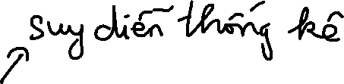




7-1 Introduction
The field of statistical inference consists of those methods used to make decisions or to draw conclusions about a population.
These methods utilize the information contained in a sample from the population in drawing conclusions.
Statistical inference may be divided into two major areas:
Parameter estimation
Hypothesis testing

Slide 4

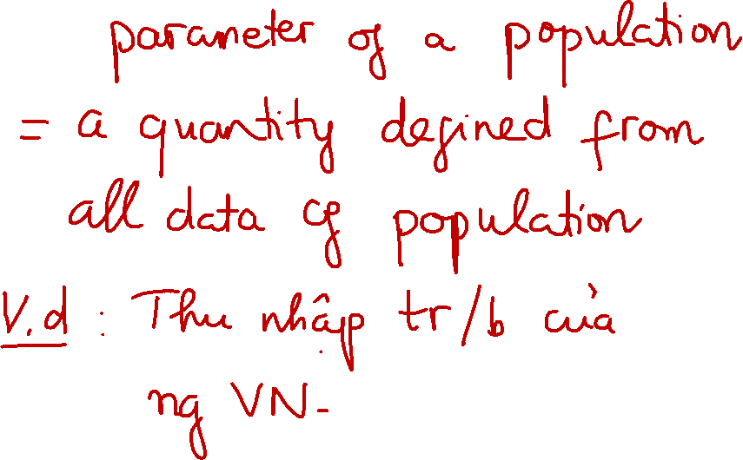

Slide 5
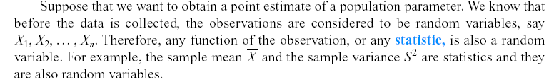

7-1 Introduction
Definition

Slide 6






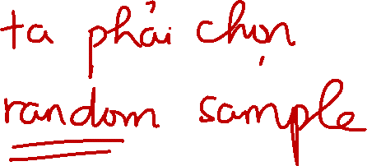









Slide 7






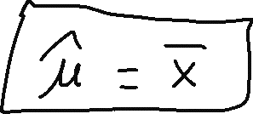









Slide 8








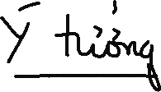


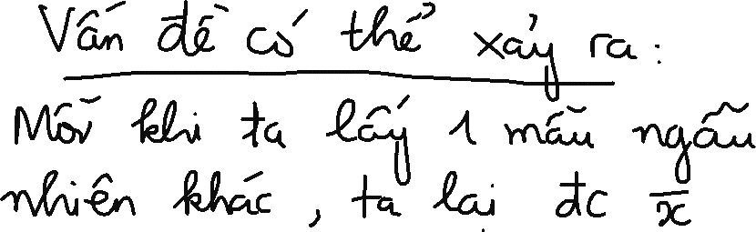





Slide 9







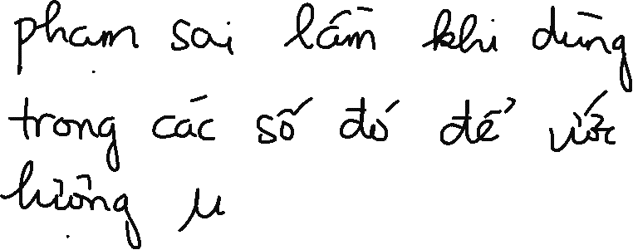


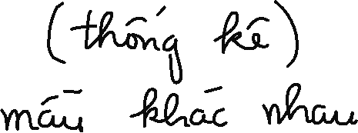



Slide 10






























Slide 11

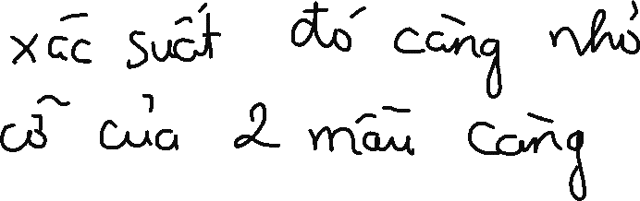



Slide 12
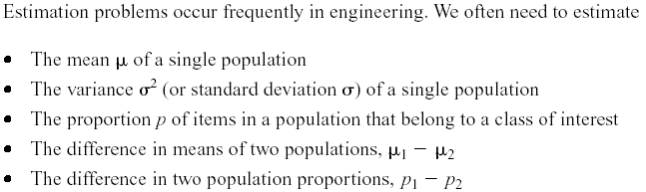
7-1 Introduction

Slide 13
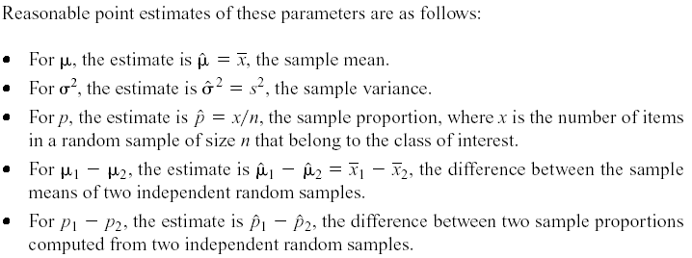

7-1 Introduction

Slide 14
7.2 Sampling Distributions and the Central Limit Theorem
Statistical inference is concerned with making decisions about a population based on the information contained in a random sample from that population.
Definitions:

Slide 15
7.2 Sampling Distributions and the Central Limit Theorem

Slide 16
7.2 Sampling Distributions and the Central Limit Theorem
Figure 7-1 Distributions of average scores from throwing dice. [Adapted with permission from Box, Hunter, and Hunter (1978).]

Slide 17
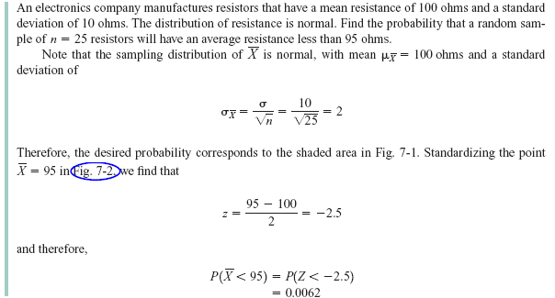
7.2 Sampling Distributions and the Central Limit Theorem
Example 7-1

Slide 18

7.2 Sampling Distributions and the Central Limit Theorem
Figure 7-2 Probability for Example 7-1

Slide 19
7.2 Sampling Distributions and the Central Limit Theorem
Approximate Sampling Distribution of a Difference in Sample Means

